Slide 1
Automating Fabric Solution Deployment Guidance and Best Practices with CI/CD for Deploying and Updating Fabric Solutions

Slide 2
Agenda
Introduction to Fabric CI/CD and ALM
Solution Deployment using the Fabric REST APIs
Fabric GIT Integration

Slide 3
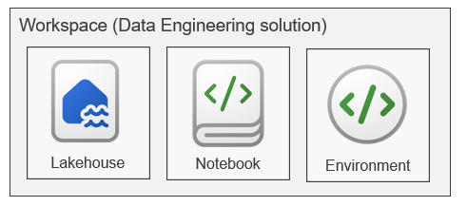
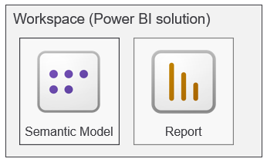
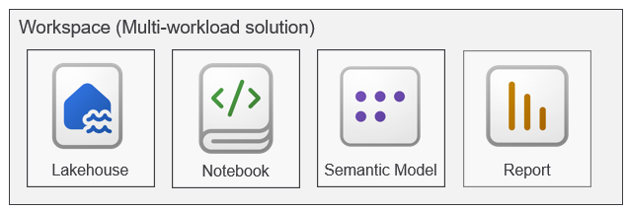
Designing Fabric Solutions
Creating lakehouse solution might involve these workspace items
Creating Power BI solution might involve these workspace items
A solution can also mix and match workspace items in single solution

Slide 4





Deploying Fabric Solutions in Multi-tenant Applications
Multi-tenant application is responsible for creating and managing customer tenants
Customer tenant created using one or more Fabric workspaces
Developer uses Fabric REST APIs to create and configure workspace items
Fabric Multi-tenant Environment
Azure AD Tenant Owned by ISV
Customer 01 Tenant Workspace
Customer 01
17 users
lakehouse
notebook
model
report
Custom ISV Application
Customer 02 Tenant Workspace
lakehouse
notebook
model
report
Customer 02
85 users
Customer N Tenant Workspace
lakehouse
notebook
model
report
Customer N
450 users

Slide 5
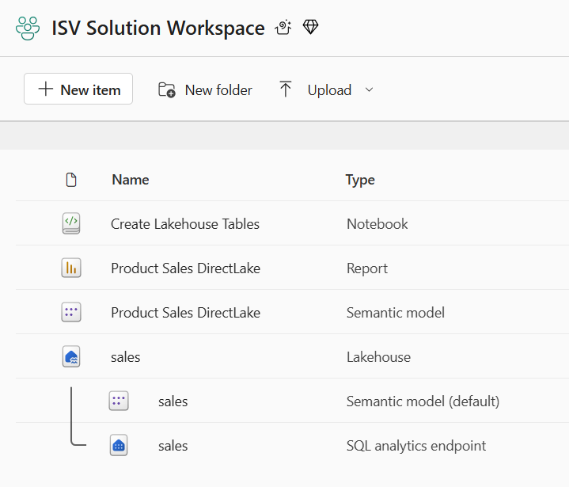
Designing Fabric Solutions for Multitenant Environments
Design workspace to serve as workspace template to provision customer tenants
Implement deployment workflow to create workspaces from workspace template
Execute deployment workflow to create customer tenants
Customer 1
Workspace
Solution Deployment Logic
Implemented using Fabric REST APIs
Customer 2
Workspace
Customer 3
Workspace

Slide 6
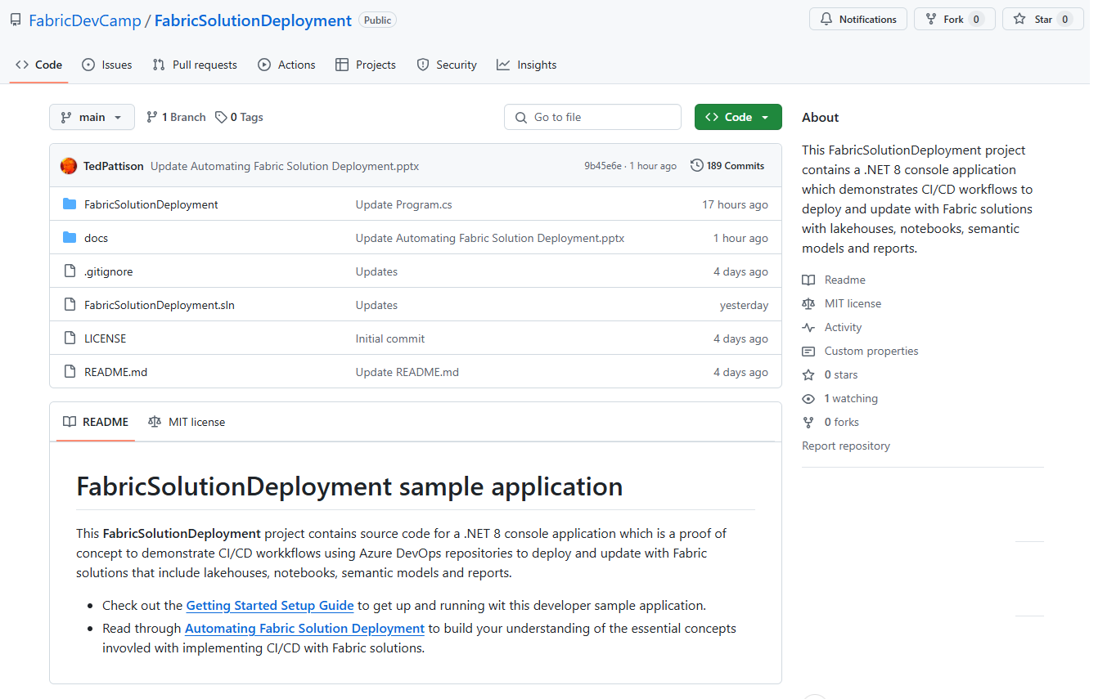
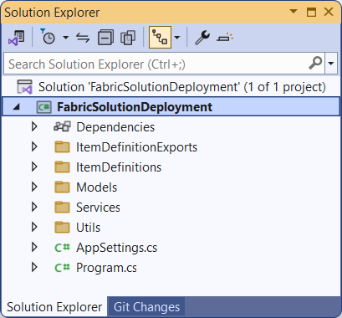
The FabricSolutionDeployment Developer Sample
Sample application demonstrating solution deployment workflows
Created as a .NET 8 console application using the Fabric REST API .NET SDK
Provides easy learning path for developers to download project and get up and running
https://github.com/FabricDevCamp/FabricSolutionDeployment

Slide 7
Solution Deployment using the Fabric REST APIs

Slide 8

Fabric REST API Design and Architecture
Fabric REST API used to create workspaces and deploy workspace items
Fabric REST API designed to be accessible to any developer on any development platform
Built using principles of REST and open security standards (i.e. OAuth2 and Open ID Connect)
Public cloud endpoint accessible through base URL of https://api.fabric.microsoft.com/v1
Your Application
Fabric REST API
access token
JSON Result
HTTP Response: 200 OK

Slide 9
Authentication and API Caller Identity
Fabric REST API supports executing API calls under two identity types
User principal (UPN)
Service principal (SPN)
Service principals often better choice for custom applications
Eliminates blocking issues with MFA and interactive login requirements
Eliminates dependencies on specific users (e.g. what to do when user leaves organization)
Custom ISV Application
Fabric REST API
Entra Id Tenant Owned by ISV
call as user
UPN
Token
call as service principal
SPN
Token

Slide 10
Fabric REST API Used for Workspace Management
Fabric REST API used to create and configure new workspace on demand
Deployment logic must associate each workspace with Fabric-enabled capacity
Deployment logic adds workspace role assignment to configure who has access
Fabric Environment
Entra Id Tenant
Workspace 1
Capacity (F4)
Workspace 2
Capacity (F16)
Workspace 3
Workspace 4
Capacity (F64)
Workspace 5
Workspace 6
Workspace 7
Workspace 8

Slide 11
Workspace Item Types
Fabric solutions built using workspace items
Developers can discover, create and manage workspace items inside scope of a workspace
Some workspace item types require item definitions for creating and updating workspace items
Creatable Workspace Item Types by Workload
Data Engineering
Power BI
Data Warehouse
Data Factory
Real-time Intelligence
Data Science
Lakehouse
SemanticModel
Warehouse
DataPipeline
Eventhouse
MLExperiment
Notebook
Report
MirroredWarehouse
Dataflow
Eventstream
MLModel
SparkJobDefinition
KQLDatabase
Environment
KQLQueryset
KQLDashbord

Slide 12
Programming with Fabric Item Definitions
Fabric items can be created and updated using item definitions
You can pass item definition when calling Create Item API
You can retrieve item definition for existing Fabric item by calling Get Item Definition
You can modify existing workspace item by calling Update Item Definition passing item definition
Your Application
Fabric REST APIs
Item
Definition
POST - Create Item
Item
Definition
POST - Get Item Definition
Item
Definition
POST - Update Item Definition

Slide 13
Fabric Item Definition Structure
When calling Create Item, you pass displayName, type and definition
Item definition includes array of parts where each part is item-specific file
File content for parts converted to/from inline base64 format when transmitted across network
Item definition for each item type requires unique set of parts
Creating notebook definition requires part for notebook-contents.py
Creating semantic model definition requires parts for definition.pbism and model.bim
Creating report definition requires parts for definition.pbir, report.json and a report theme file
displayName:
Create Lakehouse Tables
displayName:
Product Sales
displayName:
Sales by Product
type:
Notebook
type:
SemanticModel
type:
Report
definition:
parts: {
}
definition:
parts: {
}
definition:
parts: {
}
notebook-content.py
definition.pbism
definition.pbir
model.bim
report.json
report-theme.json

Slide 14
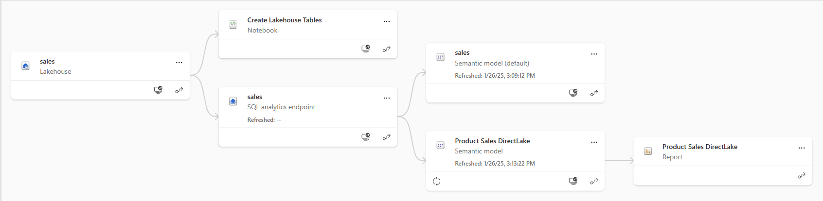
Understanding Workspace Item Dependencies
Many workspace items have dependencies on other workspace items
Notebook definition depends on workspace id and lakehouse id to reference its default lakehouse
DirectLake semantic model definition depends on connection string to SQL endpoint of lakehouse
Report definition depends on semantic model id

Slide 15
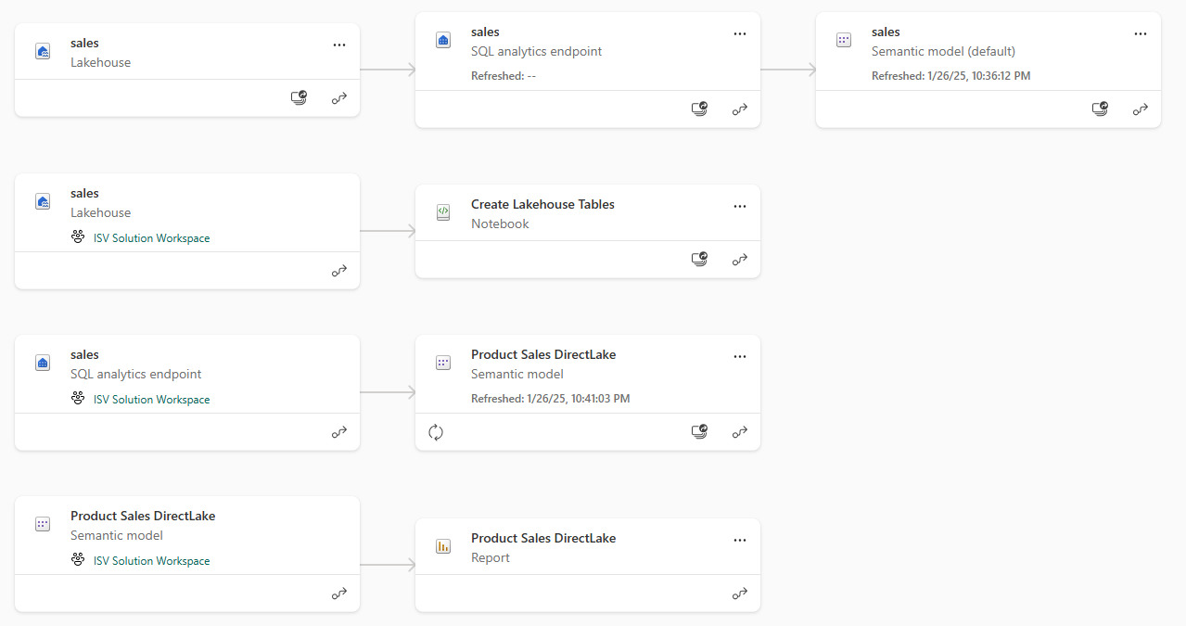
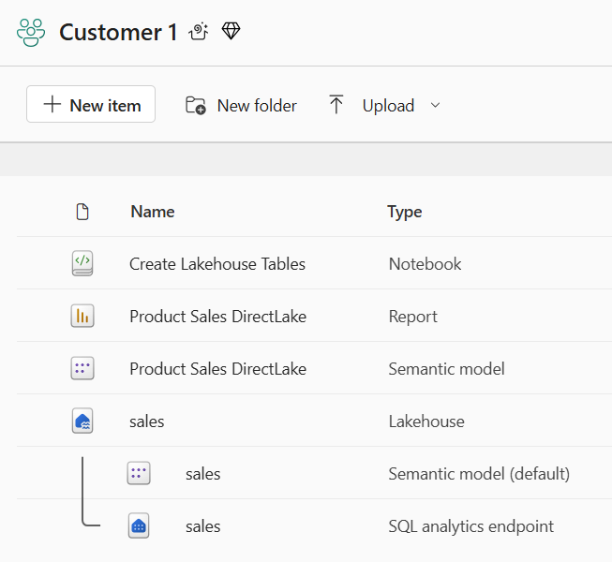
Creating Workspace Items with Dependencies
Design workflow to create workspace items with dependencies last
Notebook definition depends on lakehouse id for its default lakehouse
DirectLake semantic model definition depends on connection string to SQL endpoint of lakehouse
Report definition depends on semantic model id
Shallow copy of template workspace is not the result you want
Workspace for customer tenant should not have dependencies on template workspace

Slide 16
Sequence of Steps in Solution Deployment Workflow
Create lakehouses
Lakehouse has no dependencies on other workspace items
After creation, track lakehouse id for later use
Query lakehouse properties to discover SQL endpoint server connect string and database Id
Create notebooks
Create notebook using item definition that includes workspace id & lakehouse id
Run notebook and monitor execution until completion to create lakehouse table schema
Create DirectLake semantic models
Create semantic model using updated item definition that includes SQL endpoint connect string
After creation, track semantic model id for later use
After creation, create & bind connection and then refresh semantic model (if required)
Create Power BI reports
Create report using updated item definition that includes semantic model id

Slide 17
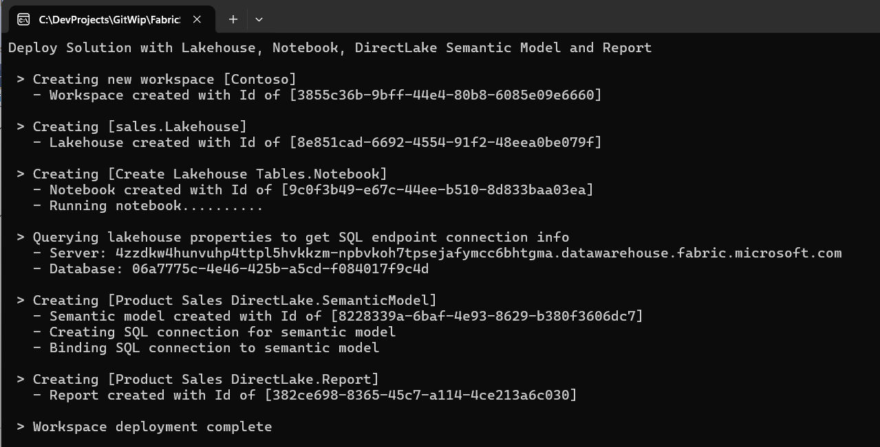
Deploying Solution using Fabric REST APIs

Slide 18
Deploy Solution from Workspace Template
Solution can be deployed from workspace designed as a template
Developer calls Get Item Definition on source workspace items
Developer modifies item definitions from source to redirect dependencies
Developer calls Create Item to create new item in solution workspace
Deploy Solution Logic
Implemented Using Fabric REST APIs

Slide 19
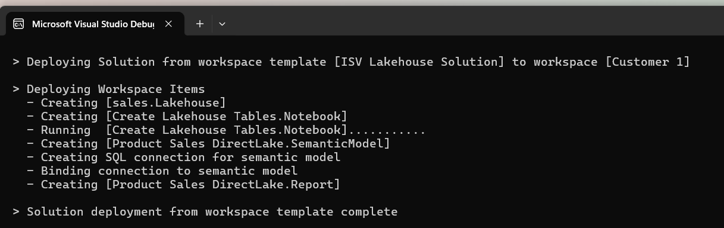
Deploy Solution Logic
Implemented Using Fabric REST APIs

Slide 20
Update Solution from Workspace Template
Developer needs a way to update existing items with change in template workspace
Using delete and create operation is not good because it changes workspace item Id
Developer calls Update Item Definition to update solution items from template items
Update logic can create new workspace items recently added to workspace template
Update logic can delete orphaned items that do not exist in workspace template
Update Solution Logic
Implemented Using Fabric REST APIs

Slide 21
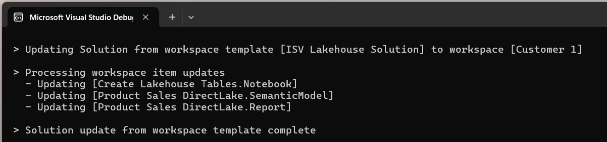
Update Solution Logic
Implemented Using Fabric REST APIs

Slide 22
Fabric GIT Integration

Slide 23
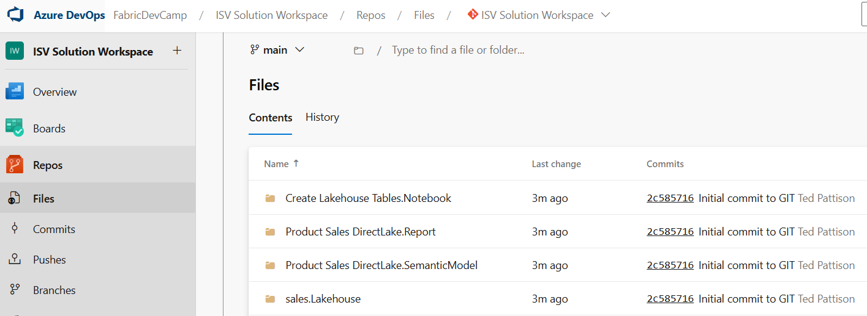
Connecting Fabric Workspace to GIT Repositories
Fabric workspace can be connected to GIT repository
Fabric currently supports GIT repositories in Azure Dev Ops and GitHub
Workspace connections can be configured by hand or through Fabric REST APIs
Once connected, workspace items serialized as item definition files in GIT repository
GIT connection to workspace provides 2-way synchronization
Changes made to workspace items can be synchronized to GIT repository files
Changes committed to GIT repository files can be synchronized to workspace items
GIT
Sync

Slide 24
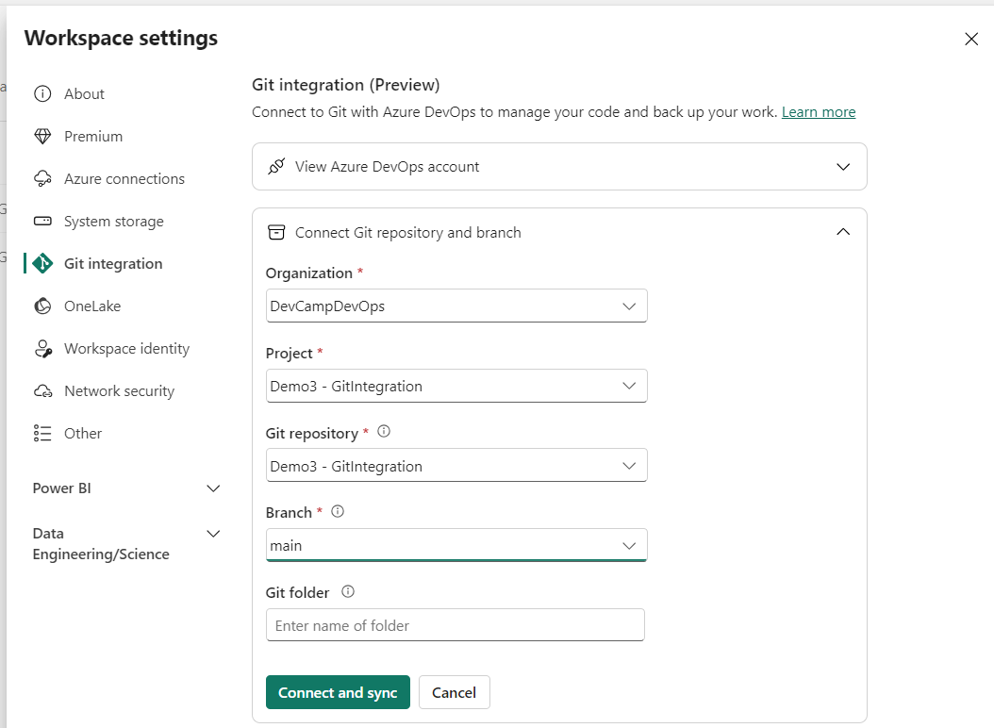
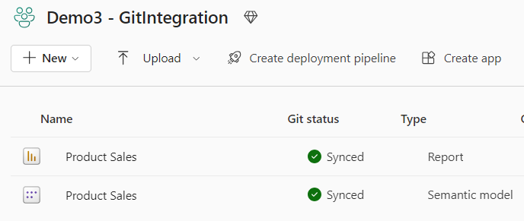
Workspace settings for Git Integration
Workspace can be connected to Azure Dev Ops repository from Workspace Settings
First, you need to create an Azure Dev Ops project and initialize its main repository
Create workspace connection to ADO repository using Git Integration tab in Workspace Settings dialog
Once connected, workspace items list shows Git status

Slide 25
Fabric GIT APIs
Fabric GIT APIs allow developer to automate creating workspace connections
Connect | Connect a specific workspace to a git repository and branch.
Disconnect | Disconnect a specific workspace from the Git repository and branch it is connected to.
Initialize Connection | Initialize a connection for a workspace that is connected to Git.
Get Connection | Returns git connection details for the specified workspace.
Commit To Git | Commits the changes made in the workspace to the connected remote branch.
Get Status | Returns the Git status of items in the workspace, that can be committed to Git.
Update From Git | Updates the workspace with commits pushed to the connected branch. ConflictResolutionPolicy helps to determine which way to sync: GIT->Workspace or Workspace->GIT
25
Microsoft Fabric
Notes:
Talk about selective commit , changes as part of roadmap
Mention irreversible nature of workspace update from GIT

Slide 26
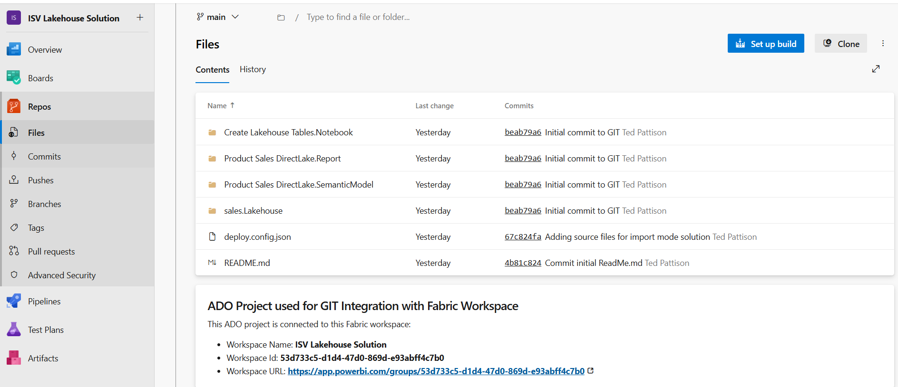
Item Definitions maintained inside Git-enabled Repository

Slide 27
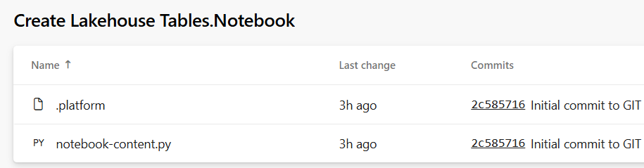
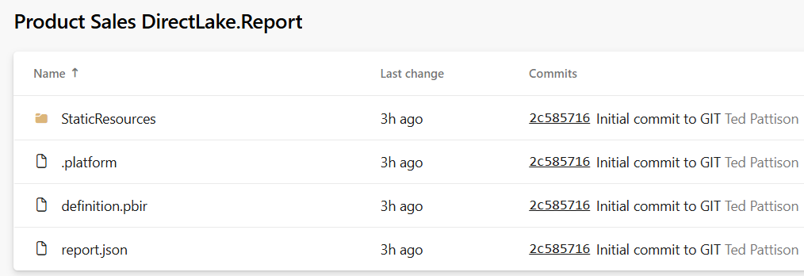
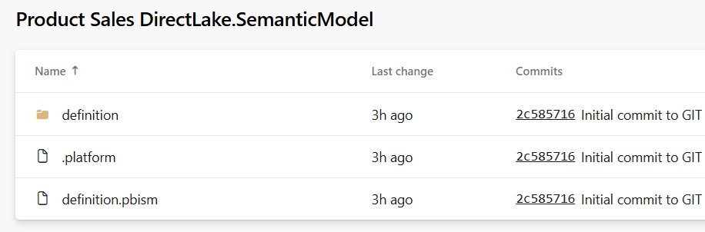
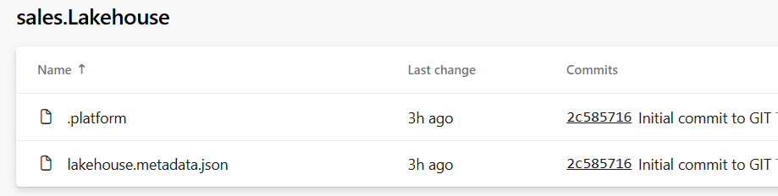
Item Definition Files
Fabric ALM strategy with CI/CD based on item definition files
Fabric automatically serializes workspace items into set of item definition files
Each type of workspace item defines the set of files that constitutes a valid item definition

Slide 28
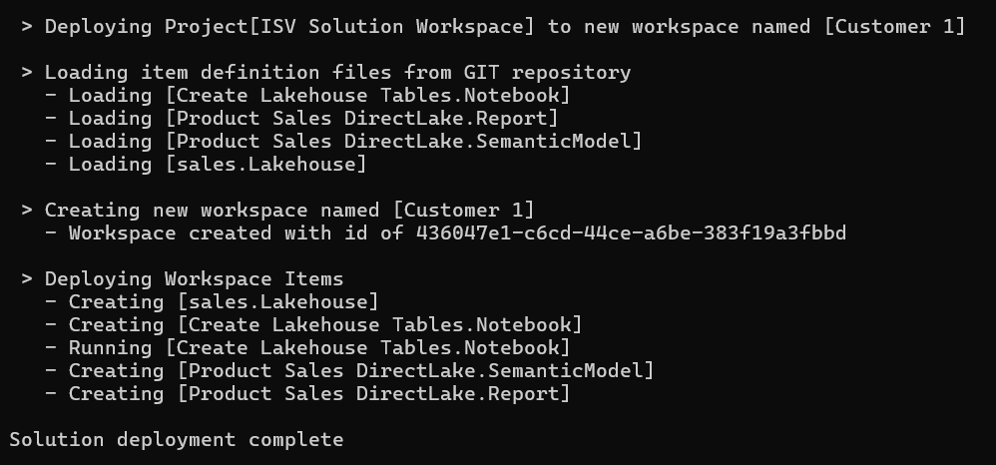
Deploy Solution from Azure Dev Ops Project
Deploy Solution Logic
Implemented Using Fabric REST APIs
GIT
Sync

Slide 29
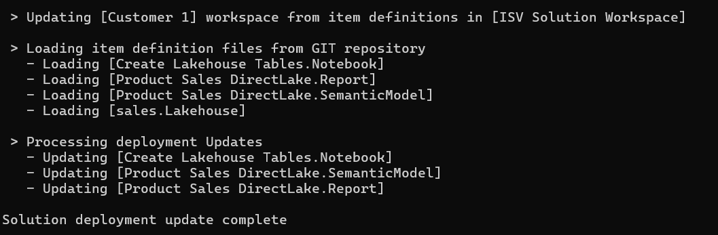
Update Solution from Azure Dev Ops Project
Update Solution Logic
Implemented Using Fabric REST APIs
GIT
Sync

Slide 30
Feature Branches
main branch serves as the stable codebase which functions as the source of truth
changes are made exclusively through a pull request (PR) process
Feature branches enable developers to work in isolation
Prevents affecting main branch
Developers can work on new features, bug fixes, change requests
Developers engage in experimental work or test/review work of other developers
Benefits to feature branches
Feature branches facilitate parallel development
Feature branches enhance code reviews
Feature branches minimize the risk of integration conflicts.

Slide 31
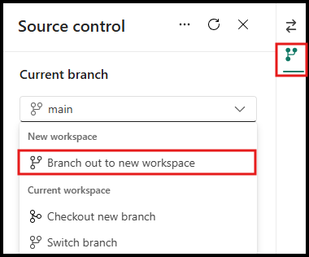
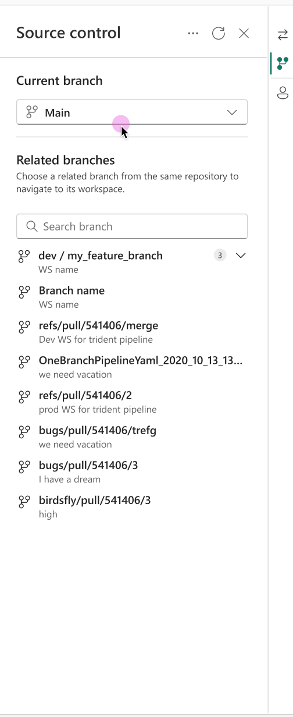
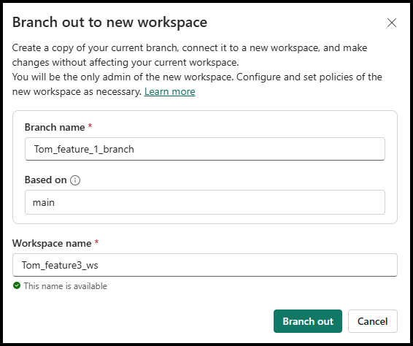
Continuous Integration – Managing Branches
Branch out to new workspace –
Just click to create isolated workspace for branch
New workspace is created and assigned to a capacity
New branch is created, based on existing branch
New branch and workspace are connected
Branch content is synced into the workspace
Developer lands in new workspace
Reduce ‘time-to-code’.
31
Microsoft Fabric
Notes:
Talk about selective commit , changes as part of roadmap
Mention irreversible nature of workspace update from GIT

Slide 32
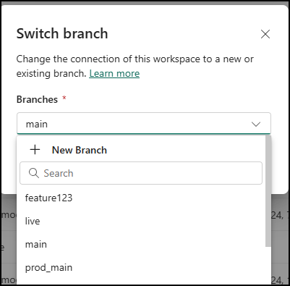
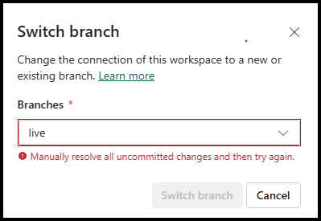
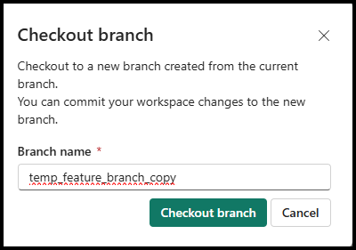
Continuous Integration – Managing Branches
Switch Branch
Enables developers to switch & sync existing workspace to a different GIT branch
Prompts in case uncommitted items
Ability to create new Devops branch from existing branch
Checkout Branch
Creates new branch & connect workspace to it
Uploads all the supported items to new branch
Useful to resolve Conflict
32
Microsoft Fabric
Notes:
Talk about selective commit , changes as part of roadmap
Mention irreversible nature of workspace update from GIT

Slide 33
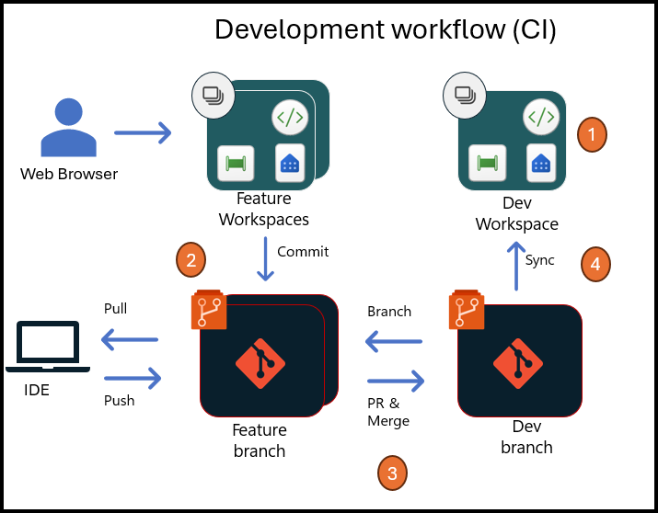
Continuous Integration : Development Workflow
Setting up Dev Workspace: The project lead sets up a Main workspace' and connects it to the "main branch“ if not already done
PR & Merge: Once a developer completes work & commit on a feature branch, they initiate a pull request to merge it into the main branch
Build Pipeline: Upon the completion of a PR, a DevOps pipeline triggered to sync updated items from GIT->Workspace & manage dependencies
Setting up Feature Workspaces: Developers creates feature workspaces mapped to feature branches using one of available options ( UX or code)
Switch Branch: It is recommended that developers do not delete their workspaces after completing a feature branch pull request
1
2
3
4

Slide 34
Summary
Introduction to Fabric CI/CD and ALM
Solution Deployment using the Fabric REST APIs
Fabric GIT Integration

